Slide 1
BUSINESS OUTCOMES
YOU CAN COUNT ON
Delivering and managing virtualized environments with HP Operations Orchestration
Uli Hitzel, Technical Consultant
thu-1500/5
HP SOFTWARE UNIVERSE
December 9-11, 2008 Vienna, Austria

Slide 2

Agenda
HP Operations Orchestration Basics
What is Operations Orchestration?
Creating and running flows
Use cases and examples
Operations and integrations
Manage your virtual enviroment with HP OO
Virtualization vendors and integrations
Features and benefits
Projects and use cases
Questions & Answers

Slide 3

Operations Orchestration:
The Basics

Slide 4
What is Operations Orchestration?
A system that automates incident resolution, change orchestration and routine maintenance tasks in data centers
Out of the box integrations for Windows, Unix and Linux servers and all kinds of ticketing systems, enterprise management software and
IT systems
Central server runs on Windows and Linux,
drag & drop authoring tool for Windows,
browser-based management interface

Slide 5
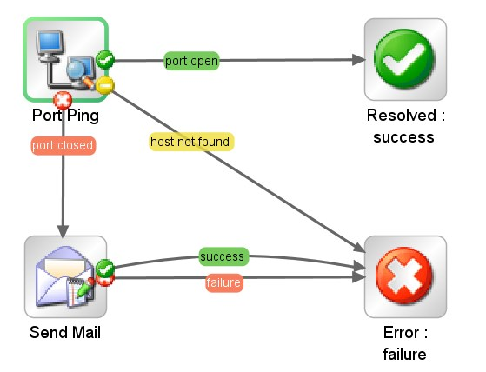
Flows
← Input parameters
flow responses
got a reply from the host. Flow successfully resolved
perform a ping request to host
server port is closed, send an email
flow exits with an error

Slide 6
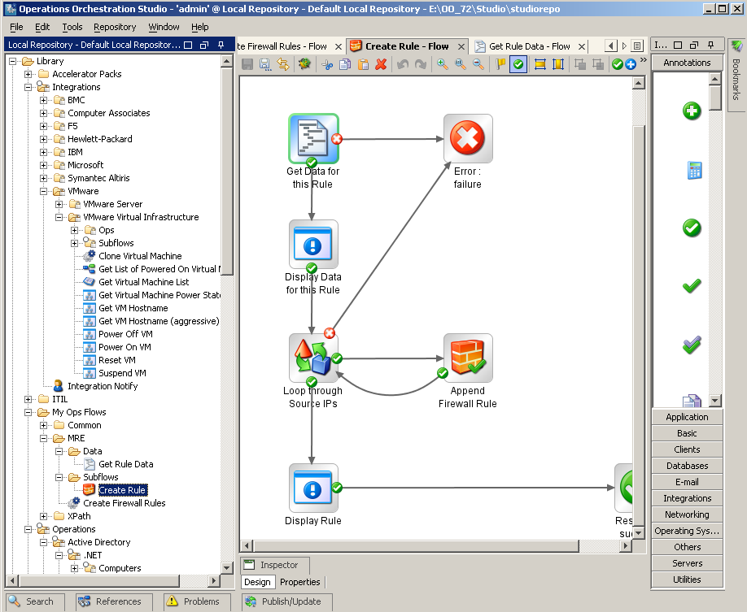
OO Studio: create and manage flows

Slide 7
Example: Routine Maintenance Task
A newsfeed-driven web portal runs hundreds of import scripts during the day in a legacy system
Quite often one of the import tasks fails and has
to be started again manually
In order to do so, an Oracle query needs
to be performed and a script to be run on the command line
Very easy for one techie, quite hard for everybody else: install client software, connectivity and license issues, passwords, exact usage...

Slide 8
→ Teach HP Operations Orchestrations how to do it, and now project managers, editors or people in call centers can run that task!

Slide 9
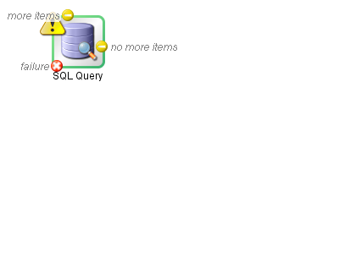
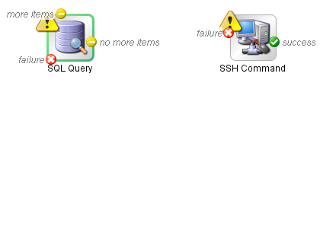
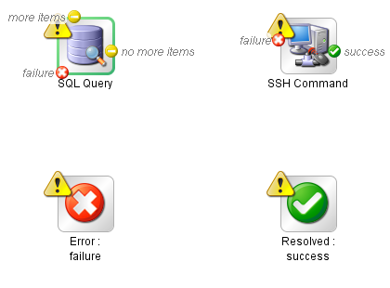
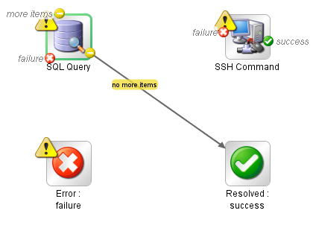
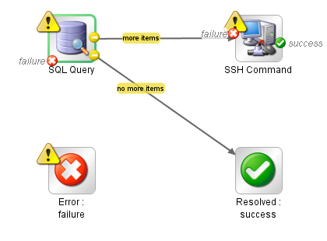
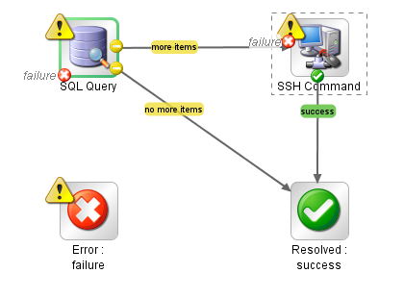
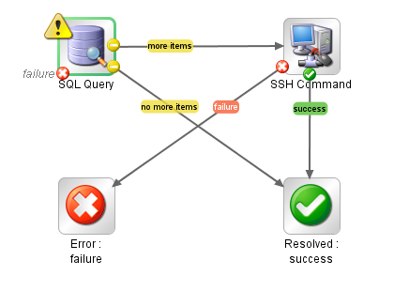
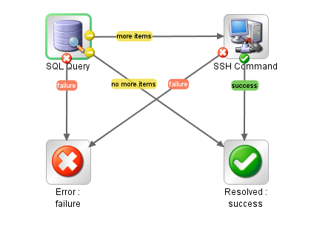
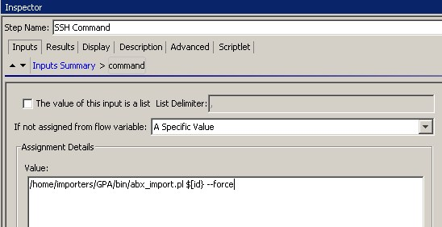
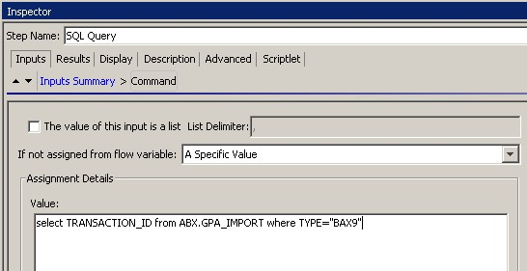
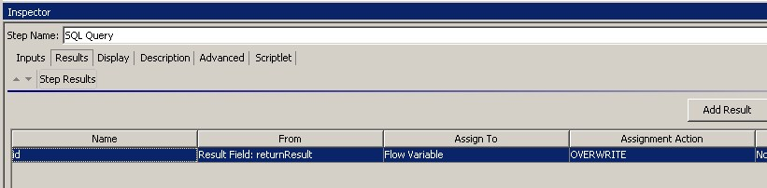
Creating a flow for this task
tell the operation
which query to perform
run the script in an SSH
session with the parameter
capture the result into
an internal variable
drag and drop the
operations into the canvas
connect the operations
and responses
drag and drop the flow
responses into the canvas

Slide 10
Running flows
In Studio: test and debug
From OO Central: guided run in a web interface
Scheduled: maintenance and routine tasks
Via webservice requests: invocation from other IT systems (e.g. Nagios)

Slide 11
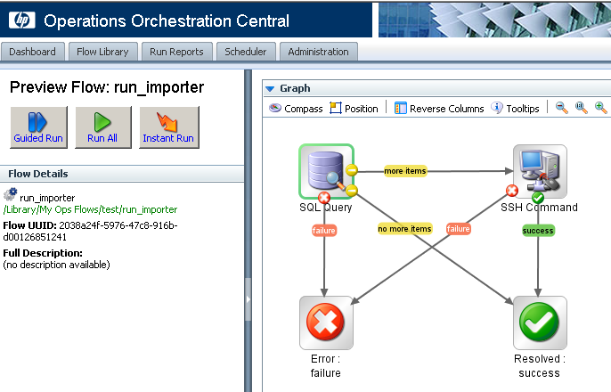
Run flow on OO Central

Slide 12
Example: Automatic Incident Resolution
A monitoring system (e.g. Nagios) continuously checks web servers for availability and performance
In large environments the number of alerts can be too high for system administrators to manage
You may want to have proper incident tracking and automatic remediation

Slide 13
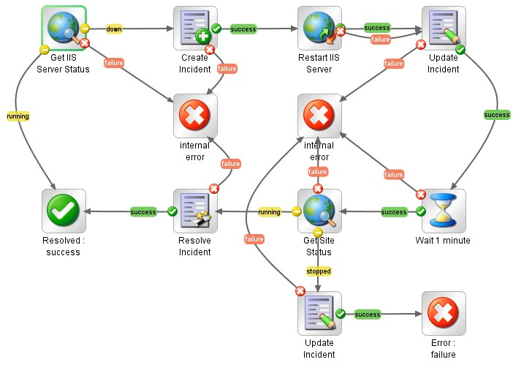
Automatic Incident Resolution: flow
check server status again
(failure case)
state in the ticket that server was restarted
server still down, update ticket
server works now, close ticket
server is down, open a ticket
check server status again
try to restart the server
flow ends with an error
flow ends successfully
wait for one minute
check server status

Slide 14
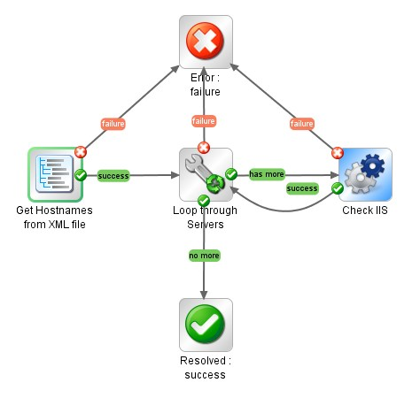
Flows can be used as subflows
now we can use this in another flow that
parses an XML file with all IIS servers
and perform health check for each one
this flow checks and restarts
one particular IIS server

Slide 15
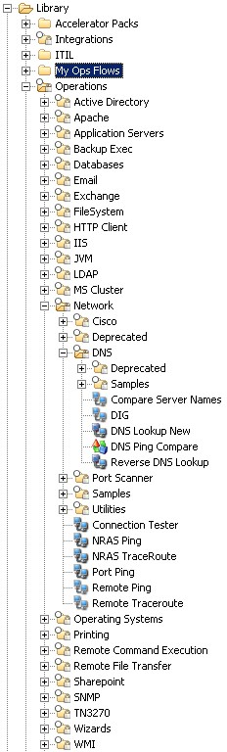



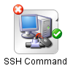





Operations and Integrations
HP OO comes with operations for flow control, interaction
with servers, operating systems, enterprise management tools,...
and many, many more...!

Slide 16
Manage your virtual environment with HP OO

Slide 17
Why virtualization?
save costs: better utilization of hardware resources
instant availability of new servers
clone machines from templates, take snapshots
turn standalone hardware into huge computing resources and clouds

Slide 18








Out of the box supported virtualization vendors
configure, clone, control
Provisioning customization
Zones
Manage
Server Automation
Coming 2009
NEW
configure, clone, control

Slide 19


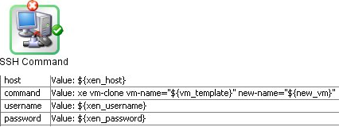



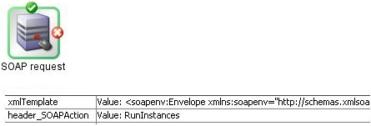

Easily create integrations for other vendors and cloud services
NEW
out of the box support for XenServer!

Slide 20
Amazon Elastic Compute Cloud (EC2)
virtual computing on demand webservice
data centers in the US and Europe
Windows and Linux virtual machines that come in three sizes:
  S * 1.7 GB RAM, 160 GB disk, 1 Xeon: $0.10/hour
  L * 7.5 GB RAM, 850 GB disk, 4 Xeon: $0.40/hour
  XL * 15 GB RAM, 1.7 GB disk, 8 Xeon: $0.80/hour
elastic IP addresses, block stores

Slide 21
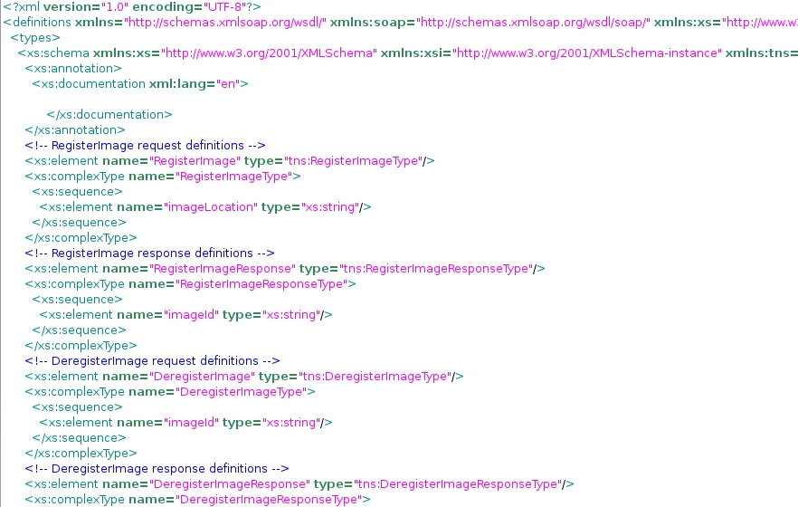
Amazon EC2: webservice description

Slide 22
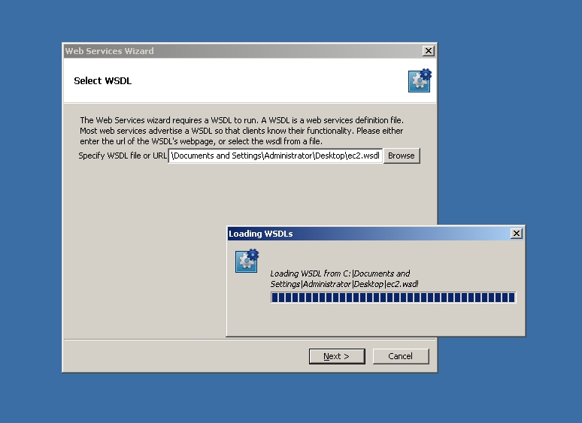
Import Amazon EC2 WSDL into OO

Slide 23
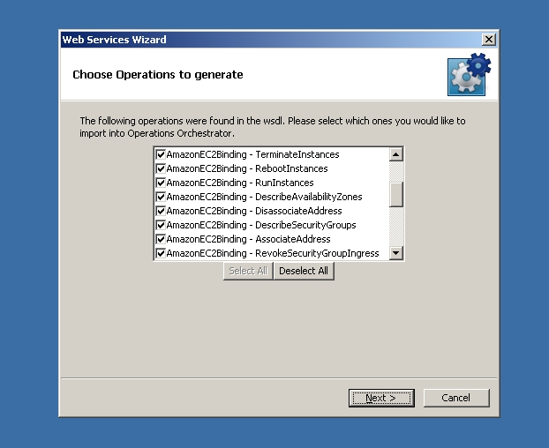
Import Amazon EC2 WSDL into OO

Slide 24
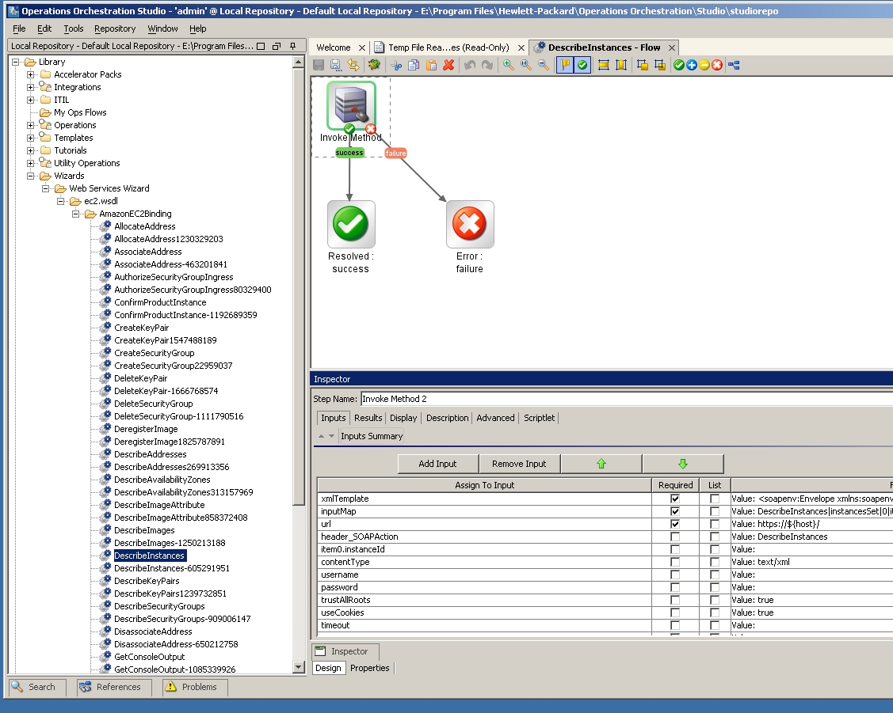
Imported Amazon EC2 operations

Slide 25
Virtualization Support Features
Provisioning
  automated builds and configuration of hypervisors
  automated creation and customization of virtual machines
  provision and configure storage and network infrastructure
Self-Service
  provide methods to stop/start/pause and reconfigure virtual machines → to be called from an end user portal or a call
  center agent
Maintenance
  take automated snapshots and backups of virtual machines
  move virtual machines across hosts
  deconstruct virtual resources, set things back to zero

Slide 26
Automation and orchestration benefits
Deploy and configure virtual resources in less time
Reduce the time you spend every day on routine tasks done manually and focus on the ones that really need your attention
Eliminate errors caused by manual actions
Have compliant resources at all times with policy and patch management
Reporting: keep a record of any action taken
GreenIT: save energy by automatically consolidating resources in off-peak times

Slide 27
Project: Virtual Data Center
Large telecommunications and infrastructure service provider in the UK
On demand delivery of virtual computing for clients
Fully automated configuration and provisioning of network, storage, hosts and virtual machines
Phase 1: 1000+ VMware ESX hosts
Integration into the user web portal for creating, modifying and managing their personal VDC
Automating maintenance tasks and teardown

Slide 28







The customer designs their VDC in a browser based user interface
database cluster
web server cluster
private network
test machines
low priority
load balancer
firewall
Submit Design

Slide 29
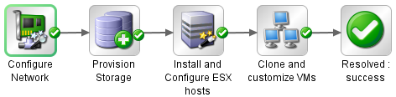


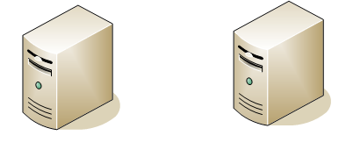



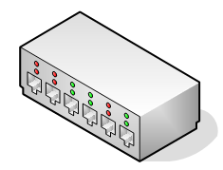


HP OO orchestrates the entire build
two bare-metal hosts
ESX
ESX
connect hosts to network
and storage
enable and configure resource
pools and high availability
create and configure networking
on the ESX hosts
connect guest operating systems
to antivirus and software updates
clone and configure
virtual machines
register hosts in Virtual Center
create a cluster from these hosts
install VMware ESX on hosts
create virtual filers
configure networking

Slide 30
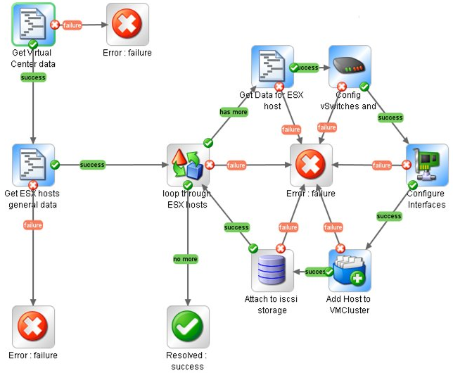
Flow: Configure ESX host

Slide 31
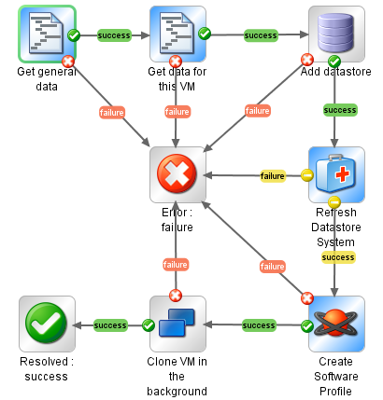
Flow: Clone and Configure a VM

Slide 32
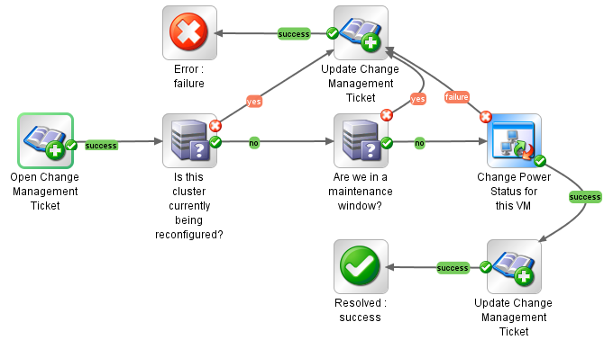
Flow: Start/Stop/Pause a VM

Slide 33
Wrap-up: Operations Orchestration
state-of-the-art technology for automated workflows
comes with out-of-the-box support for a large number of IT systems
can talk to any system that has either a command line interface or a webservice API
has been used in large-scale projects to deliver and manage virtualized environments

Slide 34

How to engage HP Software Professional Services
Come and visit our Booth # O1/19
Contact any HP Software Sales Representative in your area
Contact your Professional Services team
  Regional Director
  Country Manager
  Client Principal
E-mail us at AskSoftwarePS@hp.com

